Slide 1

Tablet Rollout

Slide 2
Summary
We recently finished testing our tabletop menu tablets in two of our pilot locations. We reached this milestone as a team via efforts that began approximately a month and a half ago and involved a variety of duties like as:
Procuring the tablets based on technical requirements
Coordinating with internal teams, such as marketing and our head chef Carter
Developing and training the staff at both locations

Slide 3
Overview
Alpha testing metrics collection:
Average our ticket time for appetizers for around eight minutes and twelve to fifteen minutes for entrees.
Have a checkout time of less than a minute.
Reduce technician issues our customers have while using the tablets.
Reduce customer wait time in lobby to be seated to under ten minutes.

Slide 4
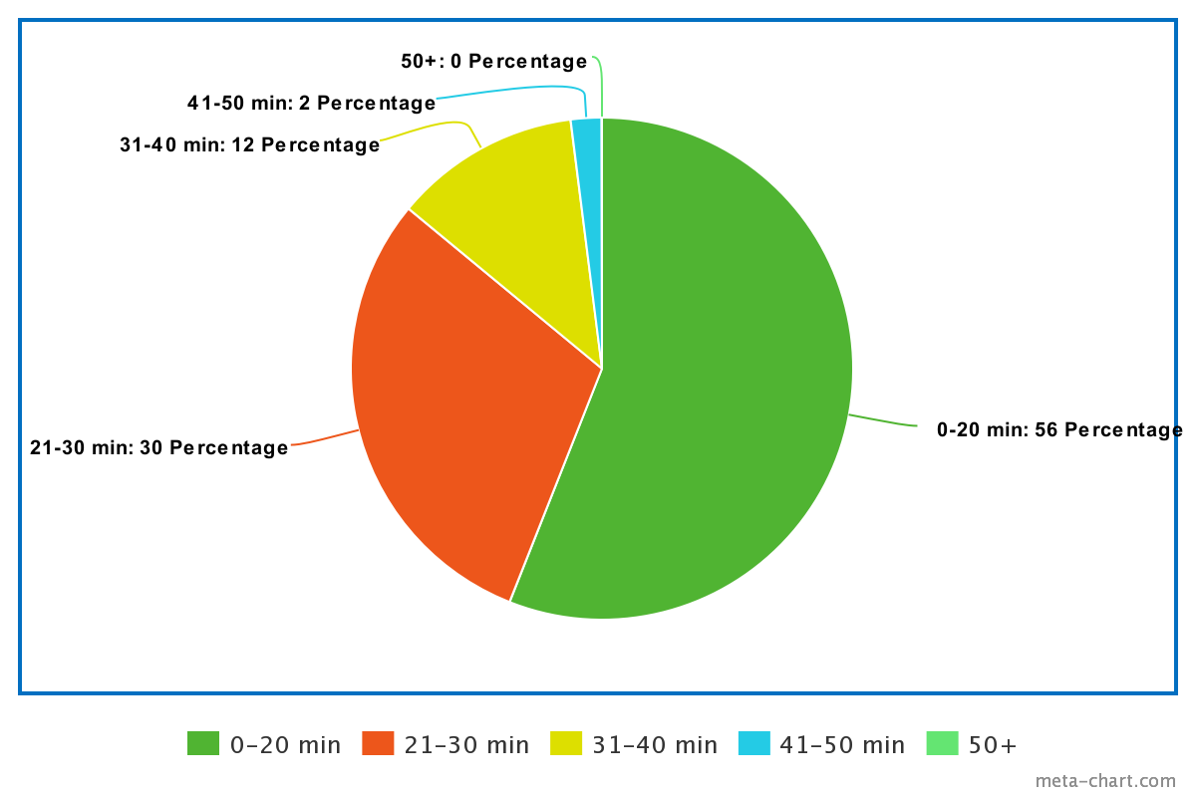
Findings
What worked?
86% of customers had a positive or neutral experience with the tablets.
86% received their food in less than 30 minutes.
82% found the checkout process quick, easy, and secure.
Opportunities:
54% of customers had to wait over fifteen minutes for a table
Only 16% of customers signed up for the Birthday Club using the tablets

Slide 5
Next Steps
Identify and improve the reasons why our customers are having to wait over 15 minutes to be seated. This can be investigated by analyzing existing table turn times and see what other improvements can be made in this area.
We found some customers were having issues with the interface and UX of the tablet itself, so this might mean some follow-up with marketing regarding the design or providing feedback to the vendor to improve the software of the tablets.

Slide 6
Next Steps
Another recommendation would be to consider giving the customer the option of using the tablet vs. interacting with a waiter. We can explore the reasons behind this with additional surveys and feedback, but in the meantime giving the customer the choice.
As we continue to refine the process and collect more data, we would like to determine reasons why customers prefer a waiter so that we can meet their needs accordingly.

